Slide 1
UNIT - II I. Reverse engineering

Slide 2
1. Introduction - Reverse Engineering
The comprehension process takes up a great deal of the total time spent on carrying out the change.
Reasons include incorrect, out-of-date or non-existent documentation, the complexity of the system and a lack of sufficient domain knowledge on the part of the maintainer.
To alleviate these problems is to abstract from the source code relevant information about the system, such as the specification and design, in a form that promotes understanding.

Slide 3
Reverse engineering alone does not lead to a change in the program;
it simply paves (covers) the way for easier implementation of the desired changes.
Changes are implemented using techniques such as forward engineering, restructuring, and reengineering.

Slide 4
2. Definitions
Abstraction - a "model that summarises the detail of the subject it is
representing“
Forward engineering - the traditional software engineering approach
starting with requirements analysis and progressing to implementation of a system.
Reengineering - the process of examination and alteration whereby a
system is altered by first reverse engineering and then forward engineering.
Restructuring - the transformation of a system from one representational form to another.
Reverse engineering - the process of analysing a subject system to:
identify the system's components and their interrelationships
create representations of the system in another form or at higher levels of abstraction.

Slide 5
Abstraction - achieved by highlighting the important features of the subject system and ignoring the irrelevant ones.
Three types of abstraction are:
(1)Function abstraction - what the function does and not how it operates
(2)Data abstrction – focus on data objects. The implementation details are irrelevant.
(3)Process abstraction - exact order in which operations are performed.
Concurrent processes - communicate via shared data that is stored in a designated memory space. Distributed processes - communicate through 'messagepassing‘ and have no shared data area.

Slide 6
3. Purpose and Objectives of Reverse Engineering
The Reverser Engineering can start from any the software life-cycle, the requirements specification, the architectural and detailed design, and the actual source code.
The most common starting point is the program source code, because the specification or design information for the system may be inaccurate or not be available. This is due of inadequate documentation.
Notes:
Pursuit - search

Slide 7
Purpose and Objectives of Reverse Engineering
The goal of reverse engineering is to facilitate change by allowing a software system to be understood in terms of
what it does,
how it works and its architectural representation.
The objectives in pursuit of this goal are
to recover lost information,
to facilitate migration between platforms,
to improve and/or provide new documentation,
to extract reusable components,
to reduce maintenance effort,
to cope with complexity,
to detect side effects,
to assist migration to a CASE environment
Notes:
Pursuit - search

Slide 8
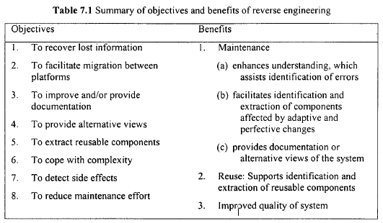
Summary of objectives and benefits of reverse engineering

Slide 9
4. Levels of Reverse Engineering
Reverse engineering involves performing one or more of the above types of abstraction, in a bottom-up and incremental manner
It entails or involves detecting low-level implementation constructs and replacing them with their high-level counterparts.
Results in an incremental formation of an overall architecture of the program
Product of reverse engineering process does not necessarily have to be at a higher level of abstraction.
If it is at the same level as the original system, the operation is commonly known as 'redocumentation’
Otherwise, the resulting product is at a higher level of abstraction, the operation is known as 'design or specification recovery’

Slide 10
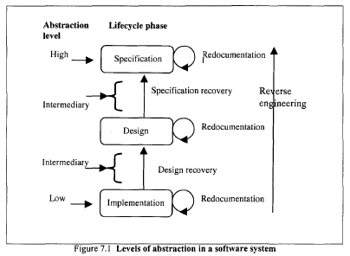

Slide 11
4.1 Redocumentation
Recreation of a semantically equivalent representation within the same relative abstraction level. Goals are
Firstly, to create alternative views of the system so as to enhance understanding, for example the generation of a hierarchical data flow or control flow diagram from source code.
Secondly, to improve current documentation. Such documentation should have been produced during the development of the system and updated as the system changed.
Thirdly, to generate documentation for a newly modified program. This is aimed at facilitating future maintenance work on the system – preventive maintenance.

Slide 12
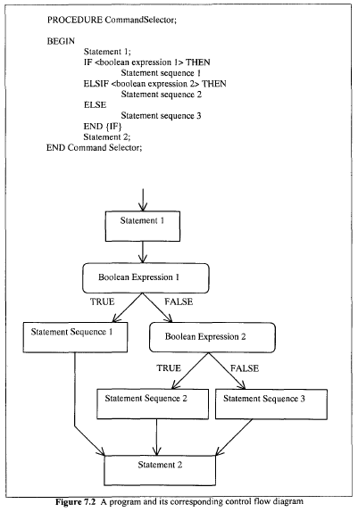
A program and its corresponding control flow diagram

Slide 13
4.2.Design Recovery
Design recovery entails identifying and extracting meaningful higher level abstractions beyond those obtained directly from examination of the source code
This may be achieved from a combination of code, existing design documentation, personal experience, and knowledge of the problem and application domains
The recovered design – which is not necessarily the original design - can then be used for redeveloping the system.
Also the design could also be used to develop similar but non-identical applications.
Example: After recovering the design of a spelling checker application, it can used in the design of a spell checking module in a new word processing package.

Slide 14
Design Recovery
Models for recovering design are,
(1) Rugaber et al. - able to recognise, understand and represent design decisions present in a given source code. Program constructs, which vary between programming languages, enable recognition of design decisions.
Examples of such constructs are control and data structures, variables, procedures and functions, definition and implementation modules, and class hierarchies.
(2) Choi and Scacchi propose an approach to extract and restructure the design of large systems ('large systems' refers to those systems with inter-modular relations)
(3) other approaches rely on knowledge about the problem and application domains.
Example : use of 'automated cliché recognition‘ . Cliches are standard problem solving techniques, such as searching and sorting, that can easily be identified by inspection. An experienced programmer can reconstruct the design of a program by recognising the cliches used.

Slide 15
4.3. Specification Recovery
In some situations reverse engineering that only leads to the recovery of the design of the system may not be of much use to an organisation .
Example: when there is a paradigm shift and the design of the new paradigm has little or nothing in common with
the design of the original paradigm, for instance moving from structured programming to object-oriented programming.
An appropriate approach is to obtain the original specification of the system through specification recovery.
This involves identifying, abstracting and representing meaningful higher levels of abstractions beyond those obtained simply by inspecting the design or source code of the software system.

Slide 16
The specification can be derived directly from the source code or from existing design representations through backward transformations.
Information obtained from other sources such as system and design documentation, previous experience, and problem and application domain knowledge can greatly facilitate the recovery process.
Recovered specification should be represented in a form that can be reimplemented easily in another programming language or paradigm.
The specification recovered can also be represented as 'object classes‘. In this case the system is represented as a set of objects and operations.

Slide 17
Uses of Specification Recovery
used to support software maintenance without necessarily requiring access to the source code.
Assists the maintainer in acquiring the appropriate level of understanding required to effect a change to a software system.
used in the development or maintenance of similar software systems.

Slide 18
4.4. Conditions for Reverse Engineering
There are no hard and fast rules as to what criteria a program must fulfil before it may usefully be subject to reverse engineering.
There some features which may serve as warning signs or indicators.

Slide 19
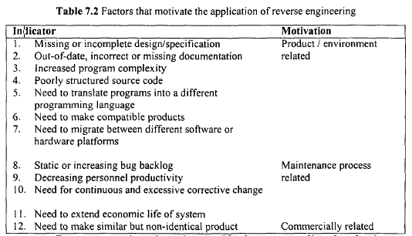

Slide 20
5. Supporting Techniques
The understanding obtained through reverse engineering can support the implementation of change through techniques such as
forward engineering,
restructuring
reengineering.

Slide 21
5.1. Forward Engineering
the opposite of reverse engineering.
It refers to the traditional software development approach - proceeding from requirements to detailed implementation via the design of the system.

Slide 22
5.2. Restructuring
Transforming a system from one representational form to another at the same relative level of abstraction without a change in its functionality or semantics
Due to transformation, the structure of programs tends to degrade.
As the degeneration continues, the programs become more complex and difficult to understand.
To control this increase in complexity, the source code needs to be restructured.
TYPES OF RESTRUCTURING
Control-flow-driven restructuring
Efficiency-driven restructuring
Adaption-driven restructuring

Slide 23
(1) Control-flow-driven restructuring:
This involves the imposition of a clear control structure within the source code and can be either intermodular or intramodular in nature.
Example:
restructuring in a small is restructuring a‘ spaghetti-like' module's code so as to comply with structured programming concepts.
restructuring in the large is regrouping physically distant routines - located in different modules - so as to give the system a more coherent structure.

Slide 24
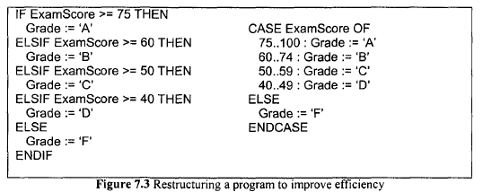
(2) Efficiency-driven restructuring:
This involves restructuring a function or algorithm to make it more efficient.
Example: replacement of an IFTHEN-ELSIF-ELSE construct with a CASE construct
CASE statement - only one Boolean is evaluated
IF-THEN-ELSIF-ELSE construct - more than one of the Boolean expressions may need to be tested during execution thereby making it less efficient.

Slide 25
(3) Adaption-driven restructuring:
This involves changing the coding style in order to adapt the program to a new programming language or new operating environment.
Example:
Changing an imperative or important program in Pascal into a functional program in Lisp.
transformation of program functions in a sequential environment to an equivalent but totally different form of processing in a parallel environment

Slide 26
5.3. Reengineering
the process of examining and altering a target system to implement a desired modification
Reengineering consists of two steps
Firstly, reverse engineering is applied to the target system so as to understand it and represent it in a new form
Secondly, forward engineering is applied, implementing and integrating any new requirements, thereby giving rise to a new and enhanced system

Slide 27
Example - Reengineering
These two steps can be further broken down as, for example, in the 8-layer Source Code Reengineering Model (SCORE/RM) proposed by Colbrook et al.
This model supports abstraction of data from source code. The first five layers - encapsulation, transformation, normalisation, interpretation and abstraction – constitute reverse engineering.
The remaining three layers - causation, regeneration and certification make up forward engineering.

Slide 28
6. Benefits of Reverse Engineering
Benefits in the areas of maintenance, S/w quality assurance and S/w reuse - reapplication of existing S/w code or design
1 Maintenance
The basic understanding gained through reverse engineering can benefit maintenance activities in various ways: Corrective change, Adaptive/perfective change, Preventive change
2 Software Reuse
software reuse refers to the application of knowledge about a software system - usually the source and object code - to develop or maintain other software systems.
The software components that result from a reverse engineering process can be reused. Often these components need to be modified before they can be reused.
3 Reverse Engineering and Associated Techniques in Practice
- Reverse engineering and associated techniques such as reengineering and restructuring have had practical applications within different sectors of the computing industry
Notes:
Corrective change: The abstraction of unnecessary detail gives
greater insight into the parts of the program to be corrected. This
makes it easier to identify defective program components and the
source of residual errors. The availability of cross-reference tables,
structure charts, data flow and control flow diagrams resulting from
reverse engineering - can assist in tracing and identifying the
variables to be changed as well as the areas likely to be affected by
the change.
Adaptive/perfective change: The broad picture made available by
reverse engineering eases the process of understanding the major
components of the system and their interrelationships, thereby
showing where new requirements fit and how they relate to existing
components. Extracted specification and design information ean be
used during enhancement of the system or for the development of
another product.
Preventive change: Reverse engineering has been recognised as
being of specific benefit to future maintenance of a system.

Slide 29
Case study 1 –Reverse Engineering
A bank has a substantial investment in a Cobol software system that is at least one million lines of code in length and has been running for over 20 years. It is used on a daily basis to perform various operations such as managing customer accounts and loans. After several years of modification - both planned and ad hoc – the system has become too expensive to maintain. As a result, the bank wants some advice on the next step to take.
Suppose that you have been employed as a software maintenance consultant.
What advice would you give the bank?
Indicate the reasons for any recommendations you make.
Case Study 2: US Department of Defense Inventory (7.8 )

Slide 30
II. Reuse and Reusability
The problems of low productivity and poor software quality are still commonplace within the software industry
One way to minimise the effects of these problems is to use previously developed software, rather than 'reinventingthe wheel' by writing all the code from scratch. This is the concept of software reuse
Software reuse, though initially targeted at software development projects, is more and more being applied to maintenance problems. It has been reported that software reuse can bring about a significant reduction in maintenance cost and an increase in productivity ofmaintenance personnel

Slide 31
Reuse
the reapplication of a variety of kinds of knowledge about one system to another similar system in order to reduce the effort of development or maintenance of that other system

Slide 32
Objectives and Benefits of Reuse
There are three major driving forces behind the concept of reuse:
to increase productivity
to improve quality
to facilitate code transportation

Slide 33
1.To increase productivity:
By reusing product, process and personnel knowledge to implement changes rather than writing code from scratch, the software engineer's productivity can be greatly increased because of the reduction in the time and effort that would have been spent on specification, design, implementation and testing the changes
2.To increase quality:
Since reusable programs have usually been well tested and already shown to satisfy the desired requirements, they tend to have fewer residual errors. This leads to greater reliability and robustness.
3.To facilitate code transportation:
The aim of code transportation is to produce code that can easily be transported across machines or software environments with little or no modification

Slide 34
However, success in achieving them can bring about benefits such as a reduction in maintenance time and effort and an increase in maintainability.
Reduction in maintenance time and effort: One benefit of reuse is a reduction in maintenance time and effort
To improve maintainability: Another benefit of reuse is that it can improve maintainability. Reusable components tend to exhibit such characteristics as generality, high cohesion and low coupling, consistency of programming style, modularity and standards

Slide 35
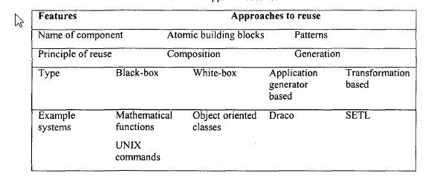
Approaches to Reuse

Slide 36
Composition-Based Reuse
In the composition approach, the components being reused are atomic building blocks that are assembled to compose the target system.
The components retain their basic characteristics even after they have been reused.
Examples of such building blocks are program modules, routines, functions and objects

Slide 37
A simple example of such a mechanism is the UNIX pipe .It is a way of connecting the output of one program to the input of another, and as such, it can be used to create a large program by combining smaller ones
Consider the problem of determining the number of files in a subdirectory This task can be split into two subtasks:
list the files and then count them. The Is command lists files.
The wc –w command counts the number of words in a file. So to count the number of files in a subdirectory, these two programs can be combined using the pipe (represented by the symbol '|') thereby giving 'Is we | w'.

Slide 38
Example
Similarly, a lecturer is a member of the University but has the additional features of employed and lectures. In a situation where we already have the component MEMBER and its associated attributes, and we want an additional component, STUDENT or LECTURER, all that is required is to construct STUDENT or LECTURER using MEMBER and implement only their additional features. Inheritance in this instance promotes efficient reuse of existing code and expedites the development process

Slide 39
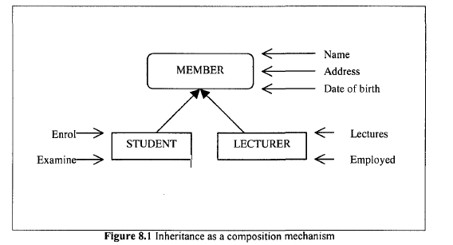

Slide 40
Black-box reuse
In black-box reuse, the component is reused without modification. Since the user does not need to modify the component prior to reusing it, only information on what it does is made available.
Examplesofwell-understood reusable components can be found in UNIX and mathematical applications in Fortran, as reflected in the high proportion of software engineers reusing them
Example 2 is black-box or white-box?

Slide 41
White-box reuse
In white-box reuse, the component is reused after modification. This approach to reuse requires that the user be supplied with information on both what the component does and how it works.

Slide 42
2. Generation-Based Reuse
In the generation approach, the reusable components are active entities that are used to generate the target system.
Here, the reused component is the program that generates the target product
Examples are application generators, transformation-based systems and language based systems.

Slide 43
1.Application generator systems
Application generators are software systems that are used to generate other applications. Provided the specification of the application to be generated is expressed in some notation, it is generated automatically.
Examples are formal specification , logic specification, knowledge-based specification, grammatical specification and algorithmic specification . Application generators are usually domain-specific.
A typical example of an application generator is yacc12 in UNIX . This is a program that generates a parser when given an appropriate grammatical specification

Slide 44
2.Transformation-Based Systems
Transformation-based systems are products that are developed using an approach whereby high-level specifications of the system are converted through a number of stages into operational programs
There are two types of transformation that can be used during this conversion process
Step-wise refinement involves continuously refining the high-levelspecification by adding more detail until the operational programsare obtained
During linguistic transformation the operational programs arederived by transforming the system through different stages. At eachof these stages, the system is represented using an intermediatelanguage which may be translated into some other intermediatelanguage until the final implementation of the system - in a givenprogramming language - is obtained.

Slide 45
example
example of a transformation system is the SETL language
This is an imperative sequential language. Its philosophy is that computations can be represented as operations on mathematical sets. The program specified in SETL is then translated into a lower-level language called LITTLE - with semantics that lie between Fortran and C.

Slide 46
3.Evaluation of the Generator-Based Systems
In principle it is easy to classify systems according tothe above generation-based taxonomy. In practice, however, it is difficult to classify a generated system as belonging to any specific category.Quite often, the systems are hybrid in nature, borrowing concepts frommore than one of the categories. For example, Neigbors' Draco systemhas features of both an application generator and a transformationsystem.

Slide 47
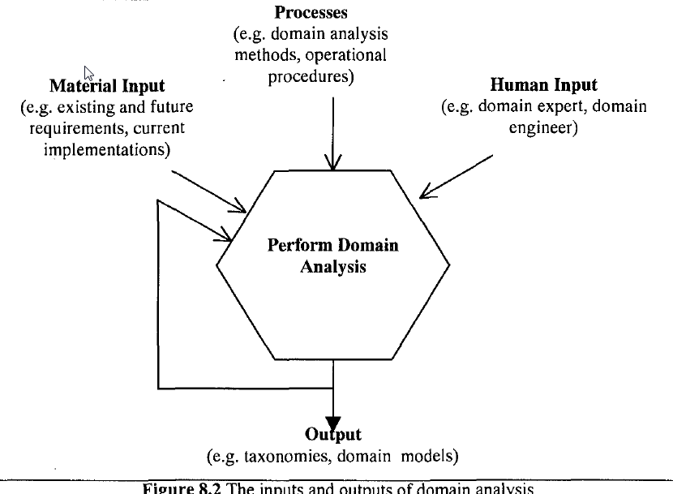
Domain Analysis

Slide 48
Domain Analysis
There are two categories of component that can be reused:
Horizontally reusable and vertically reusable components
Horizontal reuse is reuse of components that can be used in a wide variety of domains, for example algorithms and data structures.
Vertical reuse is reuse of components that are targeted at applications within a given problem area.

Slide 49
Domain analysis
domain analysis: a process by which information used in developing and maintaining software systems is identified, captured, and organised with the purpose of making it reusable when maintaining existing systems
Domain analysis is best performed by a domain expert who has experience of developing many systems in the same domain. It is especially important to organisations that are specialised in particular software systems for a designated problem set

Slide 50
Advantages of domain analysis
The repository of information produced serves, as an invaluable asset to an organization. The information can be used for training other personnel about the development and maintenance of software systems belonging to the domain in question
One of the problems with the data processing industry is the high turnover of personnel - especially in maintenance departments – thus depriving organizations of the valuable expertise gained from previous projects.

Slide 51
Disadvantages
It requires a substantial upfront(open) investment. This can be a risky venture for the organization because there is no absolute guarantee that the results of the domain analysis will justify its cost.
It is a long-term investment whose benefit will not be realized until the organization observes some increase in productivity and a reduction in the cost of maintenance as a result of reuse.

Slide 52
6. Components Engineering
The composition-based approach to reuse involves composing a new system partly from existing components.
Two main ways to obtain these components are,
The first process is design for reuse
The second way is reverse engineering

Slide 53
6.1.Design for Reuse
Characteristics of Reusable Components
with reuse, components should be designed and implemented in a way that shields them from too many changes when they need to be reused.
Reusable Components development and maintenance must be guided by sound design principles.
Generality: The potential use of a component for a wide spectrum of application or problem domains.
Examples software systems are database and spreadsheet packages which have been designed to accommodate the needs of a wide variety of users.
domain-specific applications such as air traffic control systems or clinical prescribing packages.
Sorting an array – doesn’t depend on size of array and type of data items (generic) which is more reuse potential payoff

Slide 54
b. Cohesion versus coupling
Cohesion (internal property) describes the degree to which elements such as program statements and declarations are related. A module with high cohesion denotes a high affinity between its constituent elements.
Coupling (external property) characterizes the interdependence between two or more modules in a given system. High coupling signifies a strong interrelationship between modules in a program.
change to one module, high coupling implies that
several other modules are likely to be affected. Loosely coupled modules are more independent and thus easier to understand and adapt for reuse.

Slide 55
c. Interaction
The interaction with the user in terms of the number of read-write statements per line of source code should be minimised
but there should be more interaction with utility functions that can be used for several purposes

Slide 56
d. Uniformity and standardisation
The use of standards across different levels of the software promotes reusability of software components.
Standards exist for,
user interface design,
programming style,
data structure design and documentation.
For example, standards help towards uniformity in the techniques used to invoke, control and terminate functions as well as in the methods used for getting help during use of the software
International standards such as the ISO 9000 quality series should accelerate the move towards reusability of software products by ensuring commonality in the documents and operational procedures pertaining to a software system.

Slide 57
e. Data and control abstractions
Data abstraction encompasses abstract data types, encapsulation and inheritance
For effective reuse, it is essential to have a clear separation between the programs that manipulate data and the data itself.
f. Interoperability
supports reuse by allowing systems to take advantage of remote services.
Example - the issue of patient identification in clinical systems. Work on Patient/Person Identification Servers will both aid system building/maintenance and make the identification more reliable.

Slide 58
Problems with Reuse Libraries
The components library plays a central role in composition-based reuse. But there are a number of problems associated with designing the library and also obtaining components from it
The granularity and size dilemma:
When designing a components library, it is important to have appropriately sized fragments to facilitate understandability and increase the generic potential.
That is the library will contain many small components, which poses problems with classifying and searching
The classification and search problems can be minimised by having a smaller number of large library fragments, but this increases the problems of understandability and genericity. Thus, there is a conflict.

Slide 59
b. The search problem:
Without an appropriate mechanism for describing the contents of a components library, it will be difficult for a user to find components that match the requirements of the system to be composed
It may take more time than would be required to write the code from scratch.
Solution: using knowledge-based technique and behaviour sampling technique
c. The classification problem:
It is important to store information in the components library on
what components it contains.
However, it is not always clear how to specify this information.
Example1 - use of functional specifications for representing components in the library
Example2 – Another classification scheme classifies the components based on three factors: functionality (what the component does), environment (where it does it) and implementation details (how it does it).

Slide 60
d. The specification and flexibility problems:
In the library, it is difficult to specify, what the system does, how it works and the constraints on its usage.
This poses problems for a user intending to undertake white-box reuse
Also during white-box reuse , it is not being able to tell which design and implementation decisions are fixed and which are flexible.

Slide 61
6.2 Reverse Engineering
The second way for reusing components
identifying and extracting components from existing systems through the analysis of both code and documentation, helped by software engineers, abstracting and generalizing these so that they become widely reusable

Slide 62
7. Reuse Process Model
Software reuse is not inherently top-down, as are some of the life cycle models (for example, the waterfall model).
In software reuse, the developer or maintainer takes a view that extends beyond single projects or systems.
Reuse involves the exploitation of commonality at many levels of abstraction besides that easily captured in code.
Reuse depends largely on the ability to analyse specific domains in order to extract maximally reusable components. Structured methodologies designed for top-down life-cycle models, however, rarely provide specific techniques to analyse domains

Slide 63
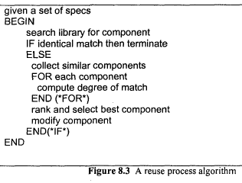
(1) Simos
"What is needed is a process model that allows for iteration between the top-down, 'problem-driven' approach and a bottom-up, 'parts-driven 'perspective.... Such a process model would correspond more closely to the real state of practice in software development than the current model, and would at least initially have a less prescriptive, more descriptive flavour."
(2) Prieto-Diaz and Freeman reuse model:
It assumes that the software engineer has already understood the problem to be solved and the specifications that are available.

Slide 64
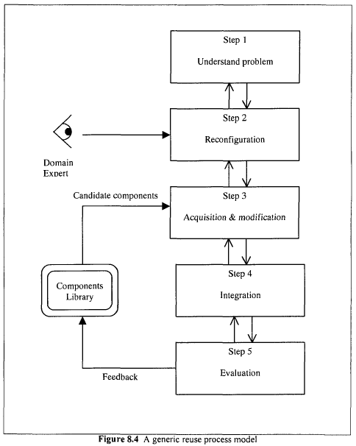
(3) Generic Reuse/Reusability Model: A model with no such assumption is proposed by Kang (4-step model). This model is further refined by Hooper and Chester to include an evaluation phase (5-step model)

Slide 65
Step 1: understanding the problem to be solved and then identifying a solution structure based on predefined components available.
Step 2: The solution structure is then reconfigured to maximise the potential of reuse at the current and the next phase.
- This means involving the domain experts of the next phase who will study the proposed solution of the current phase and identify reusable components available at the next phase.
- Several techniques can be used to identify reusable components . The criteria for selection are based on factors such as functionality, logic and pre and post-conditions.

Slide 66
Step 3: Preparing the reusable components identified in the solution structure in readiness for integration.
- This involves acquiring reusable components, modifying and/or instantiating them for the problem being solved.
- components that cannot be acquired or that are uneconomic to adapt, new ones are developed.
Step 4: Integrating the completed components into the product(s) required for the next phase of the software life-cycle.

Slide 67
Step 5: The experience from the preceding steps is used to evaluate the reusability prospects of two categories of component .
The first category is those components that need to be developed for the sub-problems for which no reusable components exist.
The second category is those components that have been obtained from the adaptation of predefined components. The result of this evaluation exercise is then used to update the current library ofreusable components.
Advantage of the generic model:
- multi-project view of development and maintenance whereby products from one project are expected to be used for other projects.

Slide 68
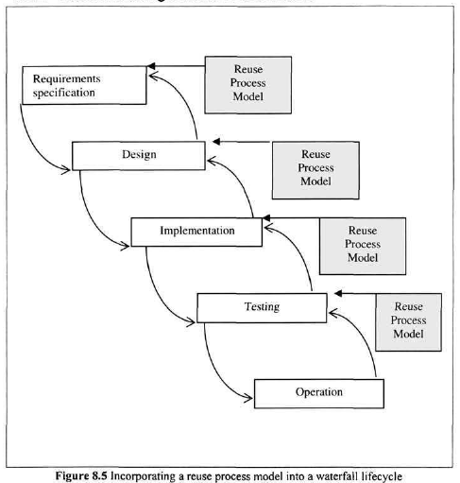
Accommodating a Reuse Process Model

Slide 69
One of the reasons that may discourage organisations from adopting software reuse is the difficulty of accommodating it in an existing software engineering process model.
One way to encourage the adoption of reuse is to assist personnel in applying reuse at the various phases of the software life-cycle they are already using.
The integration of a reuse model such as Kang's may help soften any resistance from personnel since it does not require the existing software engineering process model to be abandoned

Slide 70
8. Factors that Impact upon Reuse
Hooper and Chester - "... if reuse is to occur in an effective way, it must be integrated into the software process in such a way that we consider reusing software as the means to satisfy requirements before we consider developing new software."
8.1.Technical Factors
1. Programming Languages
2. Representation of Information – design (Ex: infix to postfix using stack)
3. Reuse Library
4. Reuse-Maintenance Vicious Cycle – minimised by good design principles for
designingcomponents and library
8.2.Non-Technical Factors
1. Initial Capital Outlay (reused depends on large libraries)
2. Not Invented Here Factor (prefer to develop own code)
3. Commercial Interest
4 .Education
5.Project Co-ordination
6. Legal Issues

Slide 71
III. Maintenance Measures
1. Definitions
Empirical - capable of being verified or disproved by observation or experiment
Entity - either an object (for instance an athlete or chunk of program code) or an event (for instance sprint or the design phase in a software development project).
Measurement - "the process of empirical, objective encoding of some property of a selected class of entities in a formal system of symbols so as to describe them“
Metric — "a criterion to determine the difference or distance between two entities, like the distance of a query and a document in Information System Retrieval Systems
Property of an entity - the attribute which is to be measured, for example the speed of sprinting or the complexity of the program.

Slide 72
2. Software Measurement
Software measurement is the 'process of objectively and empirically quantifying an attribute of a software system and the process connected with its development, use, maintenance and evolution'

Slide 73
In general, there are three software maintenance-related entities whose attributes can be subjected to measurement: process, product and resource
A process is any software-related activity such as change analysis, specification, design, coding and testing.
A resource is input to a process, for example personnel, hardware and software.
A product is any intermediate or final output resulting from a software process such as system documentation (for example, specification and design), program listings, test data, source code and object code.

Slide 74
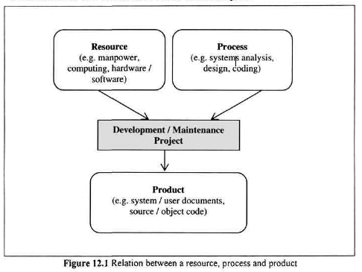

Slide 75
In software measurement, two types of attribute can be identified: internal and external
An internal attribute is one which can be measured in terms of the process, product or resource itself. For example, complexity, modularity and reusability are internal attributes of the source code of a program.
An external attribute is one which can be measured with respect to the relation of a process, product or resource to its environment, for example the maintainability of program source code or productivity of software personnel.

Slide 76
we can measure the attribute of a software product, for example the complexity of a program's source code is by counting the number of lines of code (200,say) in the program.
We can also measure the attribute of a software
process, for instance the effort required in making a change (30 personhours).

Slide 77
Software Measure and Software Metric
The result of a software measurement process is known as a software measure.
A measure is the assignment of numbers (such as LOC) or any other selected symbol during measurement.
A measure can also be a mapping of the entity (for example, program source code) to the attribute (for example, complexity).
Thus, an entity can have more than one measure for the same attribute; that is, more than one mapping.

Slide 78
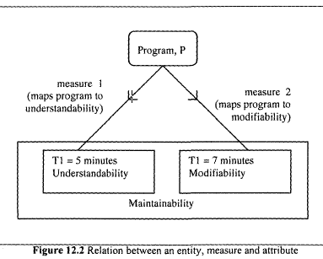
Two factors can be used to assess the maintainability of a program, P: understandability and modifiability .
Understandability is the time, T1, required per module to determine the changes required.
Modifiability is the time, T2, required per module to effect these changes.
Any of the times, T1 or T2, can be used to quantify the maintainability of P. In that case there will be two mappings; from P to T1 (measure 1) and from P to T2 (measure2). These mappings are illustrated in Figure below.

Slide 79
3. Objectives of Software Measurement
(1) Evaluation
There is a need for maintainers to evaluate different methods, program libraries and tools before arriving at a decision as to which is best suited to a given task.
Ex: During reuse, the maintainer may be faced with the problem of evaluating the suitability of a candidate component obtained from the reuse library.
(2) Control
There is a need to control the process of software change to ensure that change requests are dealt with promptly and within budget.
As DeMarco says, "you cannot control what you cannot measure“

Slide 80
(3) Assessment
In order to determine whether or not the maintenance process being used is achieving or will achieve the desired effect, an assessment of the process must be undertaken.
(4) Improvement
With measures of quality and productivity, management is able to set targets and monitor progress in achieving those targets. If the targets are not met, then corrective actions can be taken.
(5) Prediction
There is a need to make predictions about various aspects of the software product, process and cost. These measures can assist a manager in the allocation of time ,personnel, hardware and software resources to a maintenance project.

Slide 81
4. Example Measures
Measures can be derived from the attributes of the software system, the maintenance process and personnel.
The most commonly used source of measures is the software system, specifically the source code.
The main reason is that very often the only information about a system available to maintainers is the source code.
Even design documentation exists, it may be out of date or inaccurate.
Thus, the maintenance measures will be centered on source code-based measures such as
size,
complexity
quality
understandability
maintainability

Slide 82
Size
measuring the size of a program is by counting the number of lines of code
Moller and Paulish define lines of code (LOC) as "the count of program lines of code excluding comment or blank lines"
KLOC
Easy to determine
There are no standards for LOC measurement and it is dependent on the programming language in question

Slide 83
Complexity
Zuse defines it as "the difficulty of maintaining, changing and understanding programs“
increasing complexity of the source code that to be modified
Program complexity includes program structure, semantic content, control flow, data flow and algorithmic complexity.
(i) McCabe's Cyclomatic Complexity
McCabe views a program as a directed graph in which lines of program statements are represented by nodes and the flow of control between the statements is represented by the edges
v(F) =e-n+2
where n = total number of nodes; e = total number of edges or arcs; and v(F) is the cyclomatic number.

Slide 84
(ii) Halstead's Measures
Halstead proposed a number of equations to calculate program attributes such as program length, volume and level, potential volume, language level clarity, implementation time and error rates
The measures for these attributes can be computed from four basic counts:
n1 = number of unique operators used
n2 = number of unique operands used
N1 = total number of operators used
N2 = total number of operands used

Slide 85
An operand is a variable or constant.
An operator is an entity that can either change the value of an operand or the order in which it is changed. Operators include arithmetic operators (for example, *, /, + and-), keywords (for example, PROCEDURE, WHILE, REPEAT and DO),logical operators (for example, greater than, equal to and less than), and delimiters.
The following formulae can be used to calculate the program length and program effort:
Observed program length, N = N₁ + N₂;
Calculated program length, = n₁log₂n₁ + 2₁log₂n₂
Program effort, E=n₁* N₂*(N₁ +N₂ ) *log(n₁+n₂)/2*n₂
The four basic counts can also be used to compute other attributes such as programming time, number of bugs in a program and understandability

Slide 86
(3) Quality: Quality is defined as 'fitness for purpose’
a. Product quality:
One way of measuring the quality of a software system is by keeping track of the number of change requests received from the users after the system becomes operational. This measure is computed by "dividing the number of unique change requests made by customers for the first year of field use of a given release, by the number of thousand lines of code for that release”.
The other measure is the number of faults that are detected after the software system becomes operational

Slide 87
b. Process quality
The degree to which the maintenance process being used is assisting personnel in satisfying change requests. Two measures of process quality are schedule and productivity.
schedule is calculated as "the difference between the planned and actual work time to achieve the milestone of first customer delivery, divided by the planned work time".
A negative number signifies a slip and a positive number signifies early delivery.
productivity is computed by dividing the number of lines of
code that have been added or modified by the effort in staff days required to make the addition or modification.
Effort is the total time from analysing the change requests to a successful implementation of the change.

Slide 88
(4) Understandability
the ease with which the program can be understood, that is, the ability to determine what a program does and how it works by reading its source code and accompanying documentation
Understandability usually has an inverse relation to complexity; as the complexity of a program increases, the understandability tends to decrease.
From this perspective, understandability can be computed indirectly from McCabe's cyclomatic complexity and Halstead's program effort measure
Understandability can also be estimated from
quality of documentation,
consistency of programming style and
the conciseness of the program text

Slide 89
(5) Maintainability
"the ease with which the software can be understood, corrected, adapted, and/or enhanced“
An example of a maintainability measure that depends on an external factor is the Mean Time To Repair(MTTR): the mean time required to effect a change
the calculation of MTTR may require information on the problem recognition time, administrative delay time, maintenance tools collection time, problem analysis time, change specification time and change time.
Several internal attributes of program source code can impact on maintainability, for example modularity.

Slide 90
(6) Cost Estimation
The cost of a maintenance project is the resources - personnel, machines, time and money - expended on effecting change
One way of estimating the cost of a maintenance task is from historical data collected for a similar task.
A second way of estimating cost is through mathematical models - Boehm's COCOMO model
- According to Boehm, the cost of maintenance is affected by attributes of factors called cost drivers. Examples of cost drivers are database size, program complexity, use of modern programming practices and applications experience of the maintenance personnel.
A third measure of cost is time in person-months required to modify a program

Slide 91
Guidelines for Selecting Maintenance Measures
There are, however, some guidelines that can be used in selecting suitable maintenance measures. These guidelines include well defined objectives, fitness for purpose, ease of use, low implementation cost and sensitivity.
1. Clearly defined objectives:These objectives will determine the measures to be used and the data to be collected.
2.Personnel involvement:Without such clear expression of the purpose of measurement, personnel may feel that the measures will be used for punitive purposes and this can impede the programme
3. Ease of use: The measures that are finally selected to be used need to be easy to use, take not too much time to administer, be unobtrusive ,and possibly subject to automation

